Slide 1
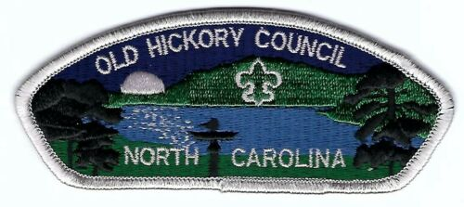
“Who Pays for Scouting”?
OR
“Why Do We Fundraise”?

Slide 2

When you think of Scouting, you might picture smiling faces around a campfire or Scouts proudly raising flags at sunrise. These are the visible and memorable adventures that shape our Scouts' lives.
Outdoor Expeditions: Camping, hiking, and exploring the great outdoors.
Skill Development: Learning survival skills, first aid, teamwork, and leadership.
Character Building: Fostering values like respect, responsibility, and empathy.
Community Engagement: Contributing through service projects and giving back.
Beneath the surface, there's a sturdy foundation that ensures these adventures are safe, impactful, and life-changing.
Training and Development: Investing in qualified leaders to guide Scouts safely.
Property and Equipment: Maintaining Camp Raven Knob and providing appropriate equipment for diverse outdoor activities at camp.
Safety Measures: Ensuring safety through certifications, insurance, and protocols.
Administrative Support: Managing registrations, communications, and program coordination.

Slide 3

TIP OF THE ICEBERG
Registration Fees
Camp and Activity Fees Scout Life Magazine Uniforms
Books
Unit Dues
BELOW THE WATERLINE
Maintenance of Camp Raven Knob
Equipment at Camp Raven Knob Camp Scholarships
Volunteer Training and Support Volunteer Recognitions
Maintenance of Service Center Council Program Development Council Communications
Marketing and Recruitment Administrative Support
Postage and Printing
Professional Staff
Support Staff

Slide 4
Youth Members
Personal savings/assistance from parents and family members
Participation in fundraising projects
  Popcorn sales
  Scout Card sales
  Other fundraising Projects
TO PAY FOR
  Uniforms
  Handbooks
  Personal Equipment
  Camp/activity fees

Slide 5
Scout Units
Weekly/monthly/annual dues
Proceeds from APPROVED fundraising projects
TO PAY FOR
  Camping Equipment
  Registration Fees
  Uniform Insignia
  Special Activities
  Program Materials

Slide 6
Chartered Partners
Each chartered organization using the Scouting program provides a meeting place and adult volunteer leadership for its unit(s).
They pay for the associated utilities and the provide the space to meet.
Some chartered organizations also provide direct assistance with unit related costs like equipment and registration fees.

Slide 7
Old Hickory Council
Financial resources for the Council come from an annual Friends of Scouting campaign, United Funds, foundation grants, special events, product sales, investment income, trust funds, bequests, and gifts of real and personal property.
No funds are raised from the government, taxes, or United Ways
These funds provide for professional staff supervision, organization of new Scouting units, service for existing units, training of volunteer leaders, and maintenance of council camps.
They also finance the operation of the local council service center, where volunteer leaders can obtain literature, insignia, advancement badges, and other items vital to the program. In addition, the service center maintains advancement and membership records.

Slide 8
Boy Scouts of America (National Organization)
Funds to support the national organization of the Boy Scouts of America come from registration fees, local council service fees, investment income, Scout Life magazines, sales of uniforms and equipment, and contributions from individuals.
These monies help to deliver the program of the BSA (through 240+ local councils) to chartered organizations that use the Scouting program to meet the needs of local youth.
The national Boy Scouts of America Foundation also provides funding for both local council needs and national organization initiatives. Most of this funding comes from specifically designated gifts made to the foundation by individuals, corporations, and other foundations

Slide 9
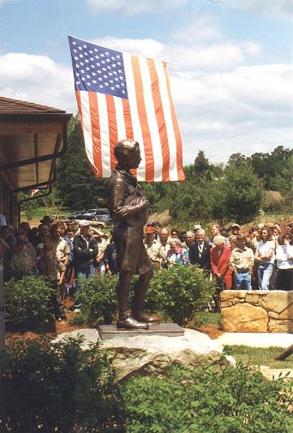
What are the council’s major functions?
Volunteer and professional training
Publications and materials
Camp Raven Knob and Raven Point; Camp Ranger & Camp Staff
Fundraising & Capital Projects
Camperships
Office facilities & support staff
Relationships/communication
Professional field service
Notes:
Reference the “True Cost of Scouting” sheet and the Friends of Scouting brochure.

Slide 10
Most families don’t even know what a “council” is, or does – or if having one or not having one is even important!
Notes:
The footprint of a council can be very different depending on where you sit. Unit leaders see it one way, district leaders see it another and parents see it still another way. And the perspective of each of these groups changes depending on how long they are involved in the program.

Slide 11
So, What if there were no “Council”?
Notes:
The best way to describe the functions of the council is sometimes to ask the question “what if there were no council?”

Slide 12
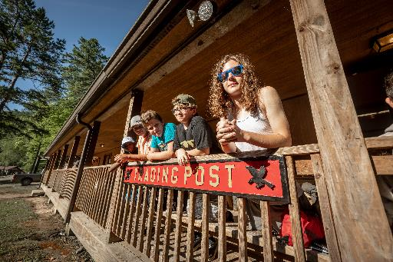
Would Scouting still be around?
Notes:
Probably, but not for very long. Most packs would die out within one year and most troops within two years. Most local Scout groups simply do not have the time, manpower, know-how, and/or relationships in the community to keep new members flowing into Scouting. One of the council’s vital functions is to develop & maintain relationships with schools so that recruiting can take place each year. Scouting doesn’t just happen, it takes work.

Slide 13
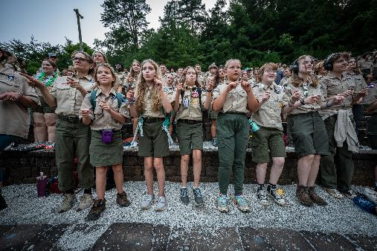
Would Churches & Civic Groups still charter units?
Notes:
Definitely not! One of the first things these agencies ask when approached about chartering a Scouting unit is “can we see your insurance certificates?” Maintaining medical and liability insurance for all Scouts, leaders and participants in Scouting activities is a critical function of the council. That coverage cost the council an average of $47,000 each year.

Slide 14
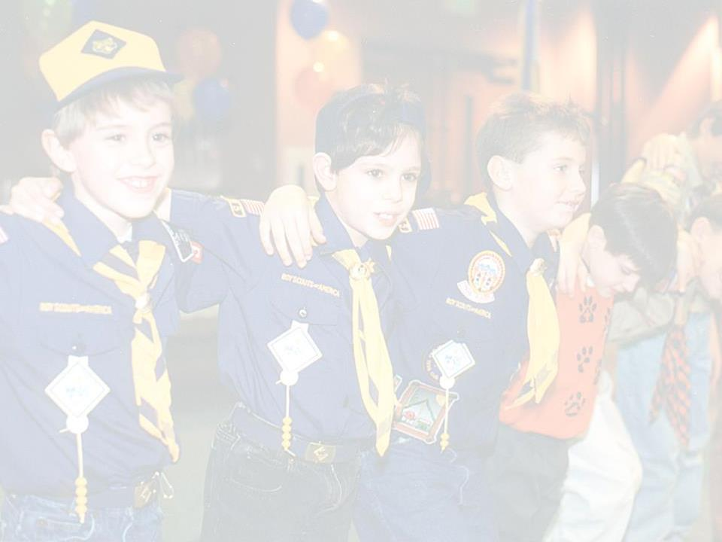
Would caring adults still volunteer to help?
Notes:
It’s doubtful. How would they be trained, and where would those training materials come from? Who would seek out these people and recruit them to help? The council’s support in training and recruiting new adult volunteers on an annual basis is vital to healthy Scouting. Scouting, contrary to popular belief, is not a simple program. In fact it’s fairly complicated, and undergoes constant revision and scrutiny to make sure training materials and methods are achieving the desired results.

Slide 15
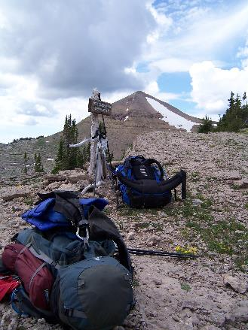
Would camporees, adventure weekends, and other large gatherings of Scouts still happen?
Notes:
Nope. These events require a lot of organization and support that just would not be possible without FOS dollars. Not to mention National Jamborees, Philmont trips, and the like. Organizing volunteers to support units through programs, training, record keeping, camps, advice, recruiting, providing insurance coverage and financial backing, etc., is a major role of the Old Hickory Council. This is a full-time effort - and then some!

Slide 16
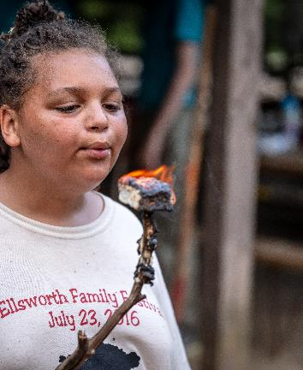
Would Scouting groups
Still go camping?
Notes:
Certainly. There are lots of places left to camp out. But Camp Raven Knob would not be one of them. The council operates our Scout camp for summer camping and year-round use by local Scouts. Without FOS dollars to support the council Camp Raven Knob would revert back to the trust and be sold to another non-profit.

Slide 17

Could youth still become Eagle Scouts?
Notes:
How would they? Where would they meet long-term Scout summer camp requirements? Who would make sure Eagle Boards of Review are in place and kept functioning? How would they obtain the award? Who would keep up with records to verify all the requirements had been met? All of these are supported by Friends of Scouting dollars. The consistency of the Eagle Scout Rank throughout the world is what makes it so special.

Slide 18
Would the Scouting program still be affordable to most, and would there be support for those who could not afford it?
Notes:
Not on your life. Scouting is kept affordable on purpose, so that all children can enjoy its benefits. For those who cannot afford Scouting or Scouting activities the council provides financial assistance. About $30,000 was given to individuals in 2013 so that they could attend Camp Raven Knob, day camps, resident camps and other activities. One of the functions of the council staff is to raise the dollars necessary to ensure Scouting remains affordable.

Slide 19
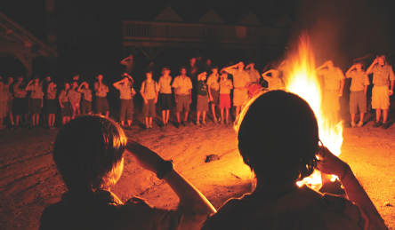
Don’t youth fees, state & federal dollars, United Ways and the popcorn sale provide enough
to operate the council?
Notes:
Not one cent of the registration fee a Scout pays to belong to Scouting comes to the council, and we don’t receive any state or federal funding. 100% of the money it takes to fund the council is generated by the council. United Way no longer supports Scouting and United Funds are slowing their support.
Our popcorn sale, still the largest single source of unit level funding, and up until 2009 a reliable source of annual financial growth for the council over the past 20 years, was down over 15% in 2012, with expectations of another decrease this year due to the reduced number of Scouts and units participating.

Slide 20
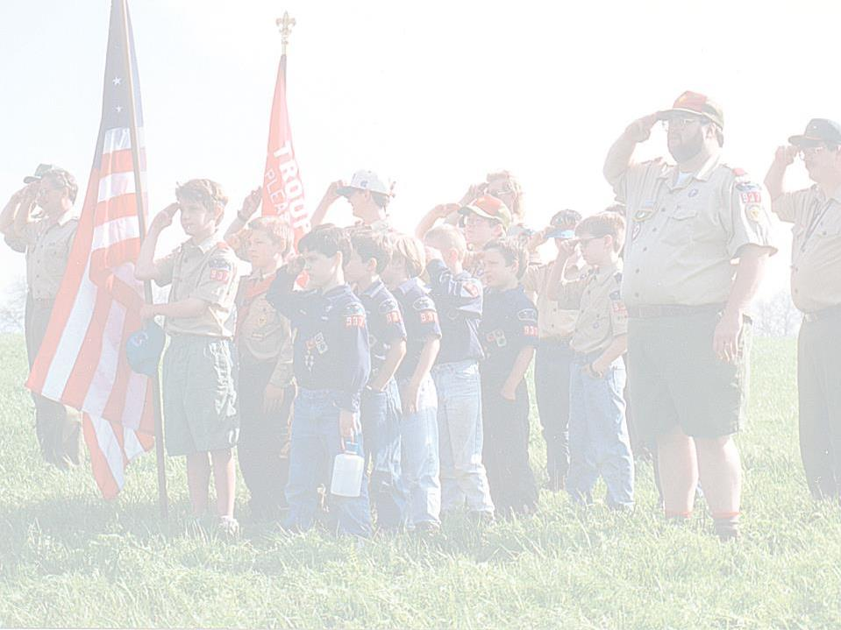
Without the council could Scouting continue as we know it?
Notes:
Not a chance. The council administers all aspects of Scouting in its geographic area, and is granted a charter annually to employ a small staff to work through thousands of volunteers to provide Scouting to our young people. That staff answers to a volunteer board that holds them accountable for the quality and growth of Scouting, and ensures that facilities, activities & resources are available for all Scouts and Scouting units.

Slide 21
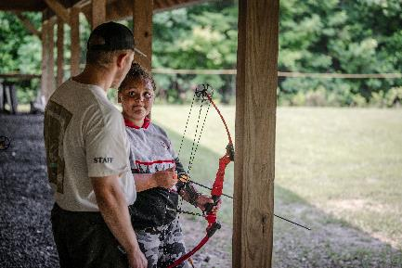
How do we know the council is operated in a sound financial manner and will be good stewards of our money?
Notes:
The Old Hickory Council is required by national BSA and our United Way partners to undergo an extensive outside audit annually. Our audit costs about $15,000 per year.
The council organization and all staff salaries are based on a national BSA scale which determines compensation and benefits.
Without the “council” Scouting would not be the program we know and love today, and in short order would become nothing more than a sitting service for parents.

Slide 22
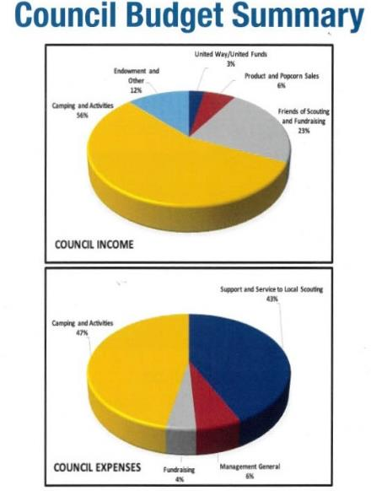
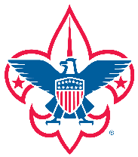
So where does funding for the Old Hickory Council come from?
Notes:
Here’s a little closer look at a budget. The right half of the graph is mostly made up of activities and camping. These two categories have expenses roughly equaling the income they generate. All other activities of the council are paid for by the three categories to the left of the graph, we call them “direct support” revenues – in other words, donated dollars ( money generated by a product sale and other revenue producing functions) which largely rely on the goodwill and image of the Boy Scouts.

Slide 23
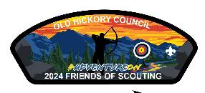
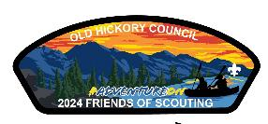
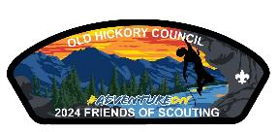
Giving Levels & Recognition
Collect the 2024 FOS Patches!
$180+ Annual Donation
Archery #AdventureOn Patch
$360+ Annual Donation
Archer #AdventureOn Patch
Canoe #AdventureOn Patch
$540+ Annual Donation
Archer #AdventureOn Patch
Canoe #AdventureOn Patch
Climbing #AdventureOn Patch
Notes:
Indicate that these are the individual recognition items for all Friends of Scouting givers, including Family Friends of Scouting gifts given through a unit.

Slide 24

Golden Eagle Club
2023 Club Membership Card
Golden Eagle Club Patch
Annual Giving Council Strip(s) based upon your giving level
  $180+ Commemorative Cardinal Patch - the state bird of North Carolina
  $300+ Commemorative Raven Patch - the totem of Camp Raven Knob
  $600+ Commemorative Bald Eagle Patch - The highest rank in Scouting & our national bird
Invitation to Golden Eagle Club Member Events
Invitation to Council Special Event Fundraisers
Annual Report Recognition
Tax Deductible Contribution Letter
Notes:
Indicate that these are the individual recognition items for all Friends of Scouting givers, including Family Friends of Scouting gifts given through a unit.

Slide 25
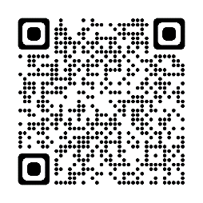
Thank You for Making a Difference!
Questions?
Give Online Using This QR Code!

